Slide 1
Preliminary evidence for learning good coding style with AutoStyle
University of California Berkeley
Antares Chen
Eliane Stampfer Wiese
HeZheng Yin
Rohan Choudhury
Armando Fox

Slide 2
We need good coding style
Coding style is important
Poor code quality requires higher maintenance
Software maintenance dominates cost
Feedback is not easy to provide
Not yet scalable: Style feedback requires dedicated instructor intervention
Not yet personal: Most existing style checkers don’t capture idiomatic usage
Notes:
Good coding style is important
Poor code is difficult to maintain
You have to understand what the code does
Even worse: software maintenance dominates production cost
Style is not easy to teach at scale
Not scalable
Style feedback requires instructor to work with submission on a student-by-student basis
Not personal
There are style checker tools such as linters
Work by comparing code to a fixed rule set
Does not capture the student’s idiomatic usage of the language

Slide 3
What is good coding style?
def combine_anagrams(words)
match = Array.new(0);
anagram = Array.new(0);
ordered_array = Array.new(0);
copy_ordered_array = Array.new(0);
for i in words
word_array = Array.new(0);
word_array = i.split(%r{\s*});
count = 0
for r in word_array
word_array[count] = r.downcase
count += 1
end
ordered_array[ordered_array.length] = Array.new(0);
ordered_array[ordered_array.length-1][0] = word_array.sort.join;
ordered_array[ordered_array.length-1][1] = i;
end
for i in ordered_array
copy_ordered_array[copy_ordered_array.length] = i
end
for i in ordered_array
for j in copy_ordered_array
if (i[0] == j[0])
match[match.length] = j[1];
end
end
if (match.length>0)
anagram[anagram.length] = match
for h in match
for q in copy_ordered_array
if (h == q[1])
copy_ordered_array.delete(q);
end
end
end
match = Array.new(0);
end
end
return anagram.sort
end
def combine_anagrams(words)
words.group_by { |word| word.chars.sort }.values
end
Concise, elegant, revealing of intent
Operationalized by ABC score
Notes:
Example
One is really long, the other is really short
The really short one is also easily readable
An expert can pinpoint what built-in functions are being used and what exactly they do in the solution
This is how we define it
We operationalize style via ABC score
A code complexity metric that is well established in the software community
Using this metric we may now compare the style between two submissions objectively

Slide 4
Learning good style
1. Self-Assessment
3. Application
2. Discovery
Notes:
To teach coding style we teach a three step method that helps the student write good coding style
Self-Assessment
The student needs to first identify opportunities to improve style
Discovery
The student needs to find pertinent information regarding improvement
Can be from documentation, stack overflow, or previous experience
Application
The student needs to apply learned information in a functionally correct manner
Iterate
The student needs to repeat the process to repeat the solution with best style

Slide 5
Current state of style tutoring
What has been done [1]
Introduced AutoStyle addressing the issue of scalable yet personal feedback
Demonstrated efficacy in improving style within a laboratory setting
What we have been doing
Study the effectiveness of AutoStyle inside a classroom
We focus on AutoStyle’s ability to scaffold step 3 – Application
[1] R.R. Choudhury et al. Scale-driven automatic hint generation for coding style, ITS 2016
Notes:
We have the high level goals we wish to achieve.
I’ll split this talk into two parts
First I’ll discuss what has been done.
<blah>
Then I’ll talk about what we’re currently working on

Slide 6
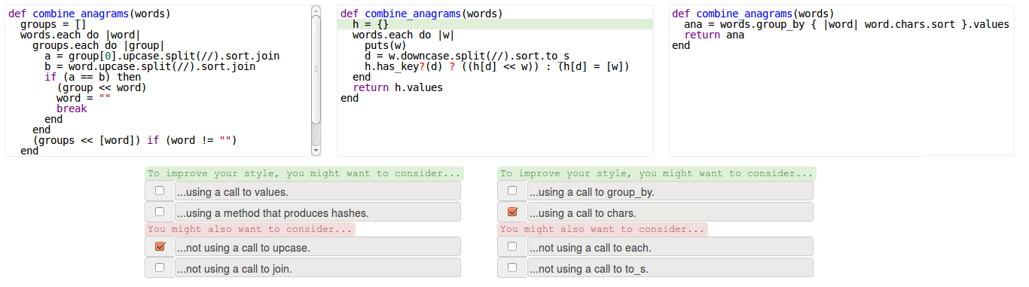
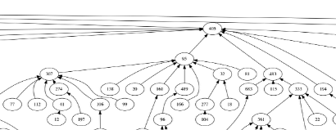
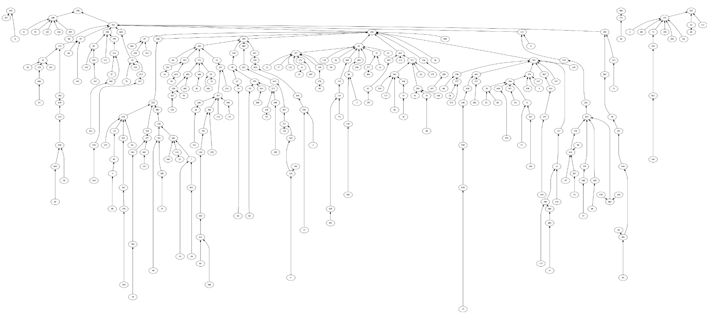
How do we handle scale.
Berkeley’s intro CS course enrolls 1,600 students this semester
Notes:
Here’s some context
MOOC scale is our friend and here’s why
Imagine the space of all solutions for a problem
Connect solutions based on if we believe it’s appropriate for a student to improve her style from one submission to another
What do we mean by mean by appropriate?
We want the student to improve incrementally
Asking the student to make drastic changes to her style requires much more effort to understand!
We CANNOT find incremental change unless we have a good sampling of the solution space
Having a massive number of submissions allows us to do this!
We can then construct a trajectory from the student’s current submission to the stylistically optimal solution

Slide 7
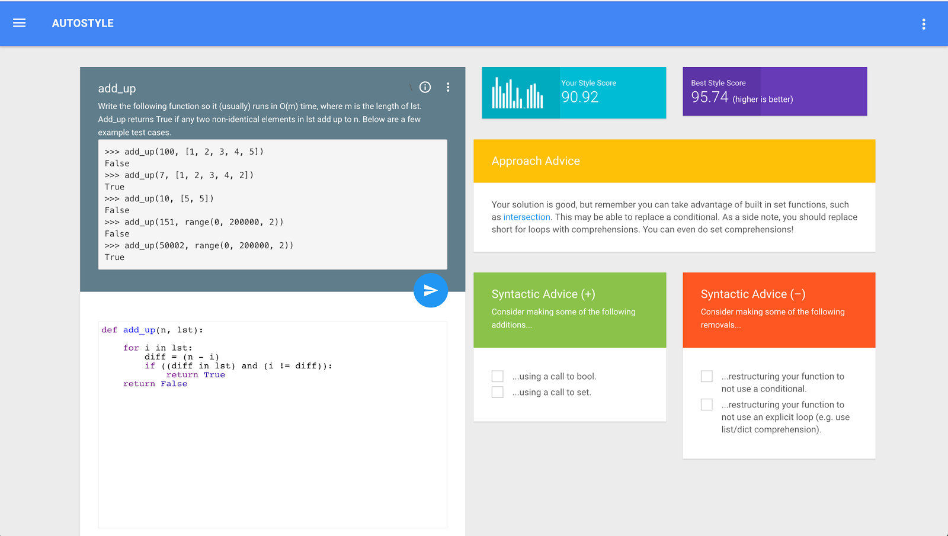
Approach hints
Targets high level understanding and approach
Syntactic hints
Targets low level, specific design patterns
Notes:
Idk just talk

Slide 8
Previous results
ITS 2016
Research question Can students improve their code quality given AutoStyle tutoring?
Two conditions
Laboratory setting
Majority of treatment reached best style
Treatment performed significantly better
Notes:
Pilot study
Question: can students improve their code quality given AutoStyle tutoring
Two conditions: control and treatment
Controlled lab setting: students were compensated
Answer to our question yes. Concluded from following
Majority of treatment reached best style score where only a fraction of the control did the same
Statistically significant
Treatment performed (statistically) significantly better. W.r.t ABC score our style metric, the treatment group scored much better than control

Slide 9
Current experiment
Targeting Application
Research question Can students learn a style idiom with AutoStyle and apply it in a post test? Does providing functional but stylistically poor starter code affect style improvement?
Single condition
Classroom Setting
Reproduce ITS2016 pilot results
AutoStyle teaches language idioms
Starter code inhibits using correct idiom

Slide 10
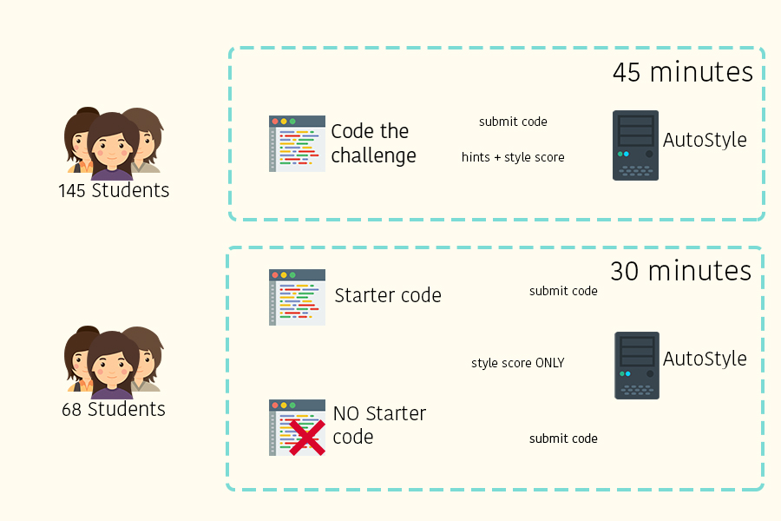
AutoStyle Challenge
Post test
ABC Score

Slide 11
Results – AutoStyle in a classroom
The pilot experiment: AutoStyle improves coding style in a controlled setting.
Result replicated in classroom setting.
A majority of the students in the autostyle challenge were able to reach the style threshold
 | % of students achieving style threshold
ITS 2016 treatment | 70%
ITS 2016 control | 13%
AutoStyle challenge | 60%

Slide 12
Results – Learning language idioms
Best solution for both parts use group_by
Students were not instructed on the idiom
Students are able to learn group_by and use it during post test
86%
61%
47%
33%

Slide 13
Results – The effects of providing starter code
Students not given starter code were more likely to use group_by in both the first and last attempt.
 | Used group_by first attempt | Used group_by last attempt
starter code | 16 % | 48 %
NO starter code | 51 % | 70 %
Chi^2 | p < 0.03
Notes:
chi-square tests on usage of group_by by condition for first attempt and last attempt were both p < .03

Slide 14
Results – The effects of providing starter code
Measure the edit distance between student’s first program and their last.
Small changes vs. reevaluating approach
Hinder student’s ability to improve style
Design fixation (Jansson & Smith 1991)?
 | Mean edit distance | Median edit distance
Starter code | 58 | 65
NO starter code | 88.7 | 101
Kruskal Wallis H-Test | p < 0.001
Notes:
How can we measure this phenomenon directly? We use an edit distance on the student’s first submission and their last submission (starter code for those who got it and self-written submission for those who didn’t)
When we compared the distance distribution between those who got starter code and those who did not, we found a very solid case of statistical significance.
Analysis
Students given starter code were more likely to make slight changes to their code than fundamentally reevaluate their approach.
If understanding idioms is a step in learning good style, then starter code may potentially hinder the student’s ability to improve their style.
More provocatively, we have reason to believe that this phenomenon holds no matter how poor the style of the code we give them
Previous studies in HCI (namely Jansson & Smith 1991 publication) outline this design fixation phenomenon where if examples are provided, students would generate solutions like said example.
Further notes on Jansson & Smith 1991:
The pair outline a framework for conceiving engineering solutions:
You have the concept space and the configuration space and there exists some mapping for the two.
Priming the student with work case examples fix the student to a point in the concept space. This point is mapped to a limited neighborhood in the configuration space. (why? Because there are only a limited number of configurations for which to apply the given example)
This works really well with coding: because you can prime the student with an idea on how to solve the problem, and if the solution is not optimal, the student will still design a kludge to hammer the solution into place.
Narratives?
Narrative number one? It’s hard for students to escape the locality of the provided starter code however with AutoStyle provided hints, students may be able to more easily escape this and come up with more novel solutions
Narrative number two? Maybe it doesn’t matter that we gave students bad code. Because there’s a study in HCI done which <insert more info about An’s study here…> and interestingly this may well apply to teaching not just style but coding in general.

Slide 15
Conclusions & ongoing work
This experiment focused on Application
In situ classroom confirms paid-volunteer study showing benefit of tutor.
Students can learn style idioms through AutoStyle tutoring
Giving “stylistically flawed” starter code may restrict student’s style edits
Launching in Berkeley’s intro CS course (N ~ 1600) this semester:
Can students learn self-assessment skills using AutoStyle?
Can students learn to discover outside info sources using AutoStyle?
Do skills learned with AutoStyle transfer to outside coding tasks?
Notes:
This experiment focused on studying how AutoStyle scaffolds the ability to apply style improvements.
Our in classroom study matched previously published result showing benefits of using AutoStyle
Students were able to learn style idioms through using the tutor
And very interestingly, we found that giving stylistically flawed starter code may dangerously prime students to a specific solution
We have very good reason to believe that AutoStyle has the ability to scaffold self-assessment and discovery
Student gains the understanding that her code can be improved via looking at her style score.
Student can learn how to analyze external resources via links (to for example documentation) in approach hints \
We really want to quantify to what degree AutoStyle supports these skills
We have a great opportunity to do so. As mentioned previously Berkeley’s intro CS course now enrolls 1600 students.
can mention verbally we have early results on "self assessment" based on pre/post test questions used in summer interventions, but we are still analyzing that data and preparing it for submission
In situ
Delivery on starter code.
Literature from HCI regarding prototypes? (can we get a forward from an tho)
Call that a post-test
Clarify that it’s distance between your starter code and finishing code
Page numbers!
AutoStyle slide is pretty static.
Context was a bit long, separate what we did in the past and be very clear about what contributions we’re making with this experiment.
When pressenting results: place research question at the top and then the conclusion
Single outline slide (tell em what youre gonna tell em)
Maybe treat AutoStyle as a black box – it exists its awesome pls red papr
There’s a lot of text.
Why is good writing important? Because it clearly conveys ideas – as with style tho.
Compare the one line thing to the really long thing example (code that does the same thing can be really long to read but can be really simple)
Mention that ABC is very well established (Or or even just chuck it because then youd have to explain what a condition is)
Target of the talk Students really fixate on things
We’ve published a style feedback thing, but we really don’t know what the effects are in the classroom setting.
Need to do a better job linking the three step (you can zoom into this one specific step and then zooming out we want to tackle these other steps)
Maybe place the three step methodology at the end.
Get rid of that squiggly edit sign

Slide 16
Thank you!
Support from IBM Faculty Award and Google inc.
Contact : Antares Chen
Email : antaresc@berkeley.edu

Slide 17
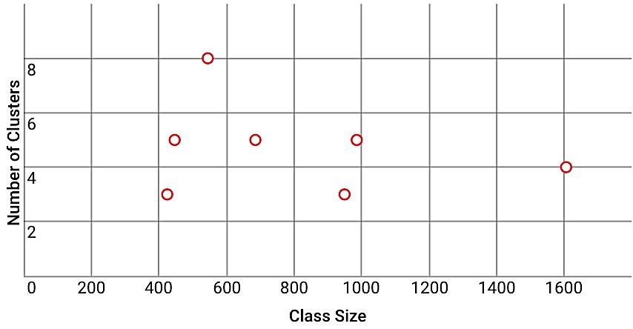
(BACK UP) Delivering feedback at scale
Leverage previous history of submissions to generate hints
Syntactic hints Incrementally build to the best solution
Approach hints cluster incoming submissions via normalized tree edit distance to capture high level design
Instructor effort is proportional to # of clusters, not class size!
# of clusters not proportional to class size!
See R.R. Choudhury et al. Scale-driven automatic
hint generation for coding style, ITS 2016
Notes:
Okay but how do we address scale?
Key idea Leverage a previous history of submissions!
All the instructor needs to do is provide AutoStyle a corpus of functioning solutions to the problem that they believe is representative of the solution space
For syntactic hints
Upon each submission, we algorithmically construct a sequence of submissions that incrementally lead to the best style solution w.r.t ABC score.
We then perform pairwise comparisons
Asking “what does the current submission not have that the next best submission does” in hopes that the student travels along the constructed sequence.
For approach hints it’s a bit more complicated
Previously we said that Alice and Bob will likely submit different code and so the feedback they would require would also be different
Turns out this is not the case!
In fact, if we cluster submissions based on the normalized tree edit distance, then we can capture clusters of code submissions sharing similar high level methods of approach.
This is perfect for approach hints as high level understanding is exactly what they target.
The instructor now simply needs to assign approach hints to each cluster
But wait, that means instructor effort is now proportional to the # of clusters and NOT the size of the class.
Furthermore, we have no reason to believe that # of clusters is proportional to class size.
Meaning we now have a control on the issue of scale .

Slide 18
(BACK UP) Coding exercises
combine_anagrams – Input an array of strings and output an array of arrays where each subarray contains an anagram group
group_array_sum – Input an array of integer array and output groups of integer arrays where each group contains arrays with the same sum
Notes:
Back up slides

Slide 19
(BACK UP) Coding examples
def group_array_sum(arrays)
hash = Hash.new
arrays.each do |a|
if hash.has_key? (a.sum) then
hash[a.sum] += [a]
else
hash[a.sum] = [a]
end
end
result = Array.new
hash.each_value do |v|
result.push(v)
end
return result
end
def combine_anagrams(words)
words.group_by { |w| w.downcase.chars.sort }.values
end
def group_array_sum(arrs)
(arrs.group_by { |a| a.reduce(0, :+) }).values
end
Notes:
Back up slides

Slide 20
(BACK UP) Usage analysis
 | Used group_by first attempt | Did not use group_by first attempt
starter code | 9 | 45
NO starter code | 24 | 23
 | p < 0.001
 | Used group_by last attempt | Did not use group_by last attempt
starter code | 26 | 28
NO starter code | 33 | 14
 | p = 0.025

